Slide 1

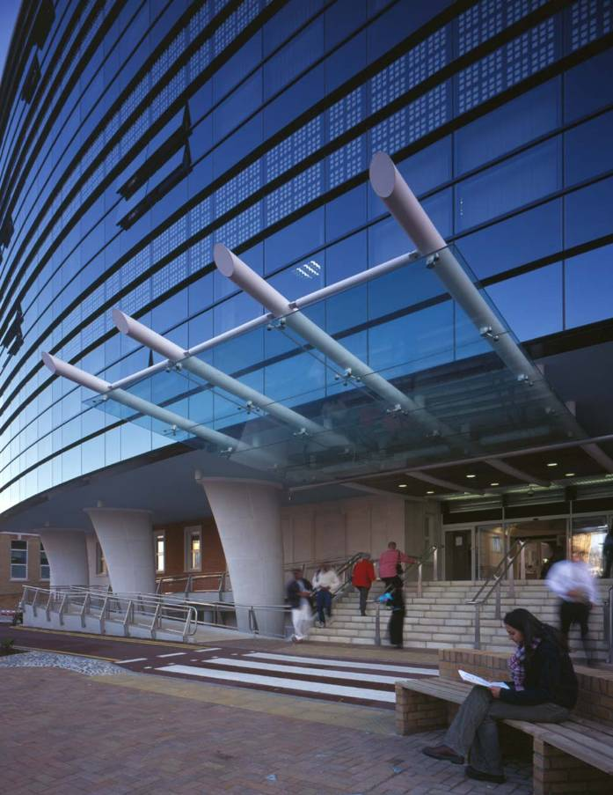
Apollo (Epic) Programme update
Current implementation and potential future workflows
Chirag Patel
ST7 Gastroenterology
Associate Medical Information Officer

Slide 2


One Unified System, Countless Benefits
Notes:
Combination of multiple clinical systems into one (First set of arrows)
Previously logging into multiple systems to view all aspects of a patients care
Some systems where only accessible to certain specialties thereby delaying patient care
Visibility of the entire patient record
Communication with other clinical teams via messaging functionality
Active notifications for results and decision support
Increased clinical safety
KCHFT shares roughly 35% of patients with GSTT a single unified health record improves the local health economy by
Preventing repeat of investigations between sites
Faster multi-departmental communication
Allowing for faster decision making across sites
Taken from KCH strategy but perfect graphic to show
Epic is one of the roots that enables us to deliver outstanding care (tree appears)

Slide 3
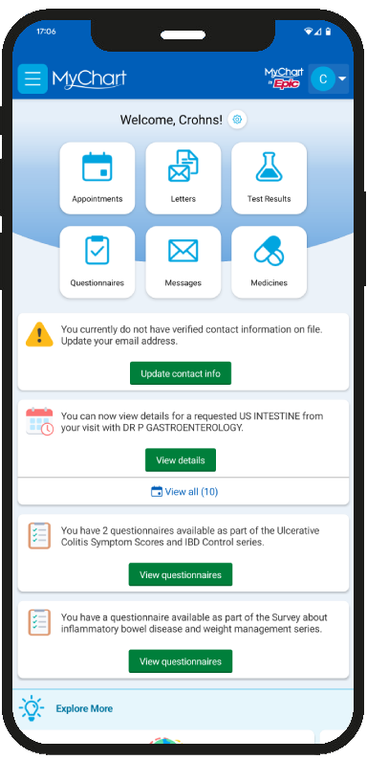
Patient Portal
Notes:
Each box appears as clicked
The patient portal has allowed patients and relatives access to…
1 “Appointments”
2 “Letters”
3 “Authorised results”
4 Patients can also update their medication list
5 And interact with clinical teams through questionnaires and messaging
For next slide
The patient portal is just one aspect of the benefits for both patients and clinicians

Slide 4
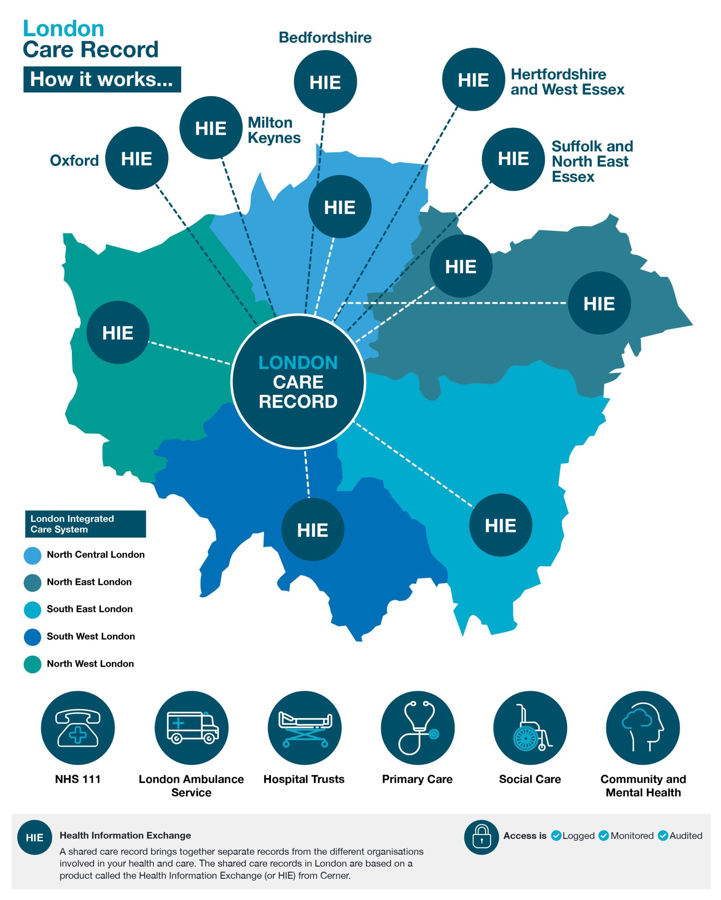
London Care Record
Notes:
LCR was pioneered and is led by Jack
Epic is integrated into the LCR
Allows
Viewing GP records
Viewing pan-London records
Upload of results
SEL is the largest user/uploader of the LCR

Slide 5
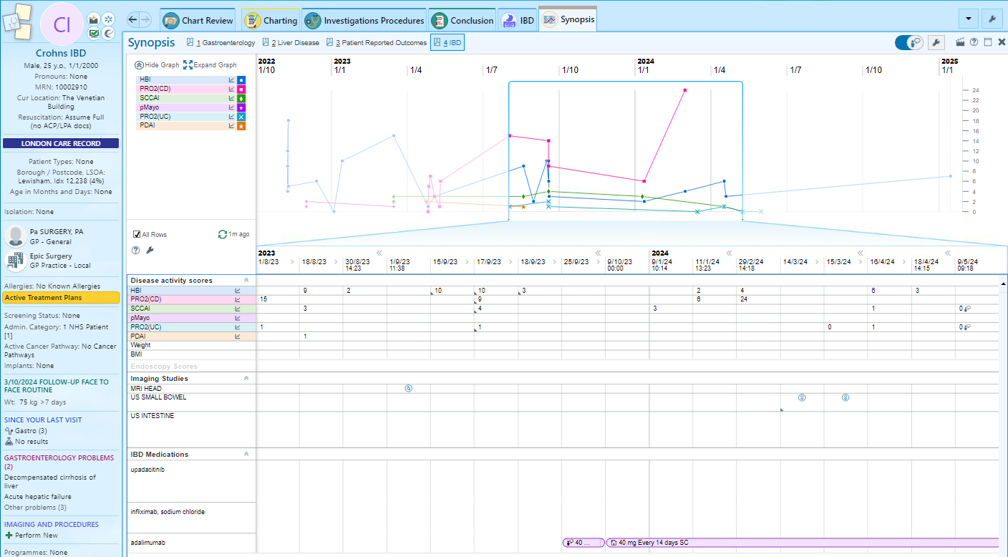
Patient history on a screen
Notes:
- As a result of this functionality with one click in clinic a clinician can via a vast array of patient data
- Here we can see a patients symptom scores that they have filled in remotely and correlate them with investigations carried out at the same time
- This allows for longitudinal view of the patients history as well as a snapshot on a single page
- As the record grows with team this will lead to more proactive decision making
Improving both patient care and clinical productivity

Slide 6
Patient Story
26 year old female patient moved to Brixton from Manchester in 2022
Referred to King’s College Hospital in late September 2023 for investigation of abdominal symptoms and diagnosed with Ulcerative Colitis
Commenced on oral immunosuppressive therapy in October 2023
Good response to therapy
  Monitored via symptom questionnaires delivered through MyChart
  Communicated with clinical teams through a combination of MyChart patient messaging and helpline calls
Whilst on holiday in Devon in June 2024 she was admitted to hospital with a severe flare
  Underwent multiple investigations including blood tests, endoscopy, and CT scanning
  Given a course of steroids and switched to intravenous rescue therapy during admission
  All documentation and investigations were visible to the Inflammatory Bowel Disease teams at both Royal Devon Hospital and King’s College Hospital via CareEverywhere
    Faster treatment when admitted to Royal Devon as all diagnostic history and management could be viewed
    No delays in receiving further doses of medication when she returned home with on going monitoring through symptom questionnaires

Slide 7
Future Developments
Notes:
The possibilities with Epic are almost limitless
Clearly the main priority at the moment is to ensure that all users, all clinicians are able to take advantage of the basic tools that Epic provides (can expand on that – making sure we’re using Epic to enable improvements in productivity, whether that’s outpatient slot utilisation, theatre utilisation or improved inpatient flow)
However I’ll highlight two potential future developments close to my own heart, which illustrate firstly Epic’s ability to deliver better patient-centred care, and secondly its potential in enabling a data-driven focus on population health

Slide 8
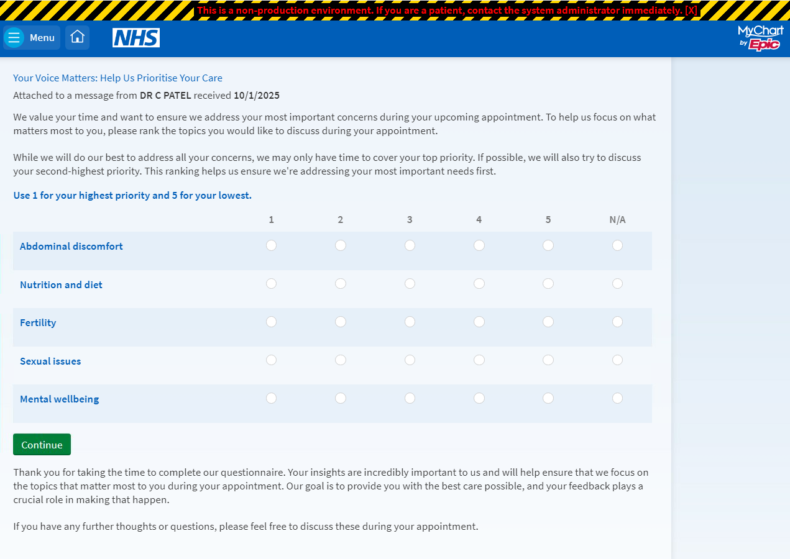
What matters to patients?
Notes:
Pilot project due to start in the inflammatory bowel disease service
Limited time in clinic
Clinicians focus on ensuring that clinical needs are met
This will allow for patients to suggest their most pressing needs and deliver a more holistic service

Slide 9
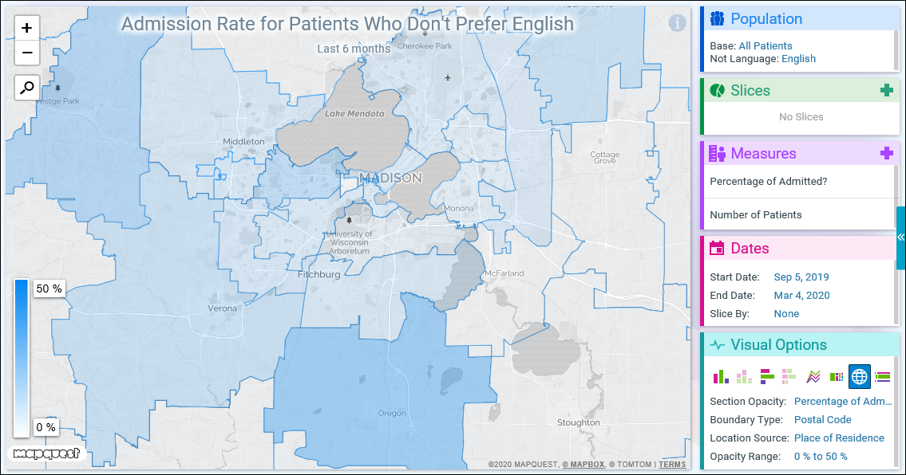
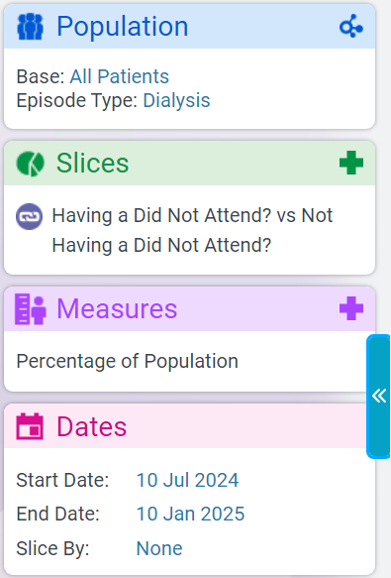
Geospatial Mapping
Equality, diversity and inclusion data
Demographic and disease burden
Service usage
Notes:
Mapping overlay for data visualisation module (SlicerDicer)
EDI data mapping
Demographic and disease burden mapping
Service usage mapping
Example of dialysis patient who missed appointments
Heat map to show areas of concentration
Allows for planning of services

Slide 10

One Unified System, Countless Benefits
Notes:
Taken from KCH strategy but perfect graphic to show
Epic is one of the roots that enables us to deliver outstanding care (tree appears)

