Slide 1

Updated Breast Screening Community Partner Guide
By the South East London Breast Screening Service (SELBSS),
Kch-tr.selbss@nhs.net
October 2024

Slide 2
Contents page
Purpose……………………………………………3
Context…………………………………………...4-5
What is breast screening?...............................6-7
Invitations……………………………………..…….8
Reasonable adjustments………………………....9
Pros and cons of attending breast screening…11
Tips for screening attendance.………………….12
Results…………………………………………….12
Breast aware health promotion……………..14
Promoting screening…………………………….15
Resources…………………………………….....16
SEL screening locations…………………....17-18

Slide 3
1. Purpose
This document is for community partners, clinical and non-clinical primary care staff, public health professionals, voluntary and community sector (VCS) and wider professionals across South East London (SEL) who engage with our clients.
We can work together to deliver “bespoke” information tailored to the needs of individual communities. The aim of this guide is to equip you with all of the information you need to discuss and promote breast screening.
We are working to increase participation in routine breast screening, raise awareness of risk factors for breast cancer and educate people on how to check their breasts.
This means we can address awareness inequalities, promote health equality and empower people to take charge of their wellbeing.
Increasing uptake over the breast cancer screening service is necessary to save lives and it is important for people to talk about this in their communities, and with family and friends.
These breast screening and cancer conversations may occur in appointments, at community events, in a targeted breast screening workshop, or even in everyday life.
This guide was produced by SELBSS based at King’s College NHS Foundation Trust, consulting with the South East London Cancer Alliance (SELCA).

Slide 4
2. Context
Breast screening uptake in SEL is still below the national target of 70%, although we are considered recovered from the dip in uptake owing to COVID-19. Factors included the COVID pandemic for the initial dip, and continued hesitancy to attend, barriers to access, fear of the screening itself or the resulting outcome, mistrust and/or a lack of public awareness.
1 in 7 women and people with breasts will get a breast cancer diagnosis in their lifetime. SELBSS is an inclusive service, including trans women on feminising hormones, intersex people, non-binary people assigned female at birth and trans men who have not had a bilateral mastectomy (removal of both breasts, which may be different to top surgery), see the Best for My Chest campaign for more information.
In the case that someone is registered male at the GP as a trans man OR is a trans woman but is still registered as a male but needs screening – we do not currently have a screening pathway for this but we are exploring this. These people currently can request a mammogram at their local hospital
Every year we screen approximately 55,000 out of our 85,000 eligible population, finding 400-450 breast cancers per year through the SELBSS. We operate 7 screening sites and anyone requiring further investigations will be invited to the Assessment Centre (Breast Radiology Department at King’s College Hospital)

Slide 5
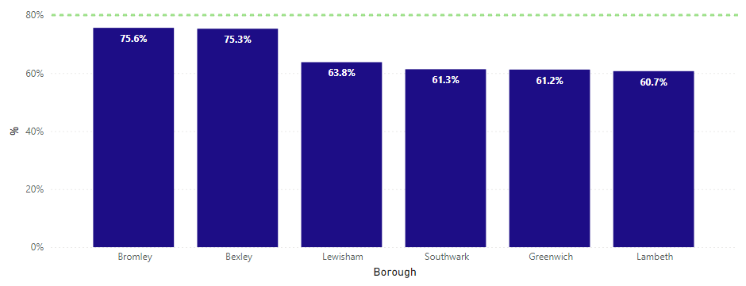
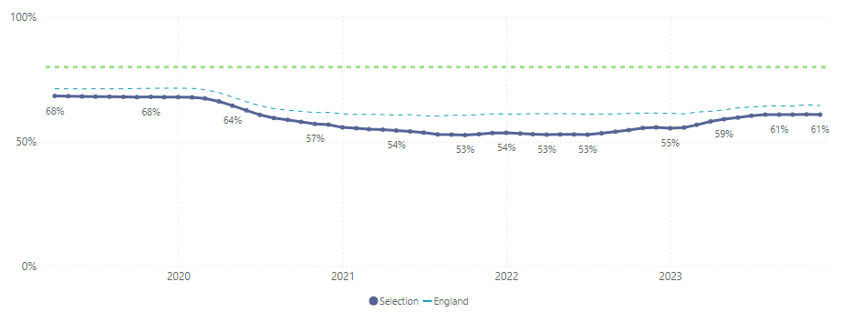
Breast screening in SEL
Uptake of screening as of December 2023
Coverage of screening as of December 2023
Open in Power BI Cancer - Population Insights Dashboard Data as of 16/02/24, 17:31 Filtered by Screening Name (is Breast Screening), Month (is Jan-24), DynamicLocalityCancer_Data (is Borough)

Slide 6
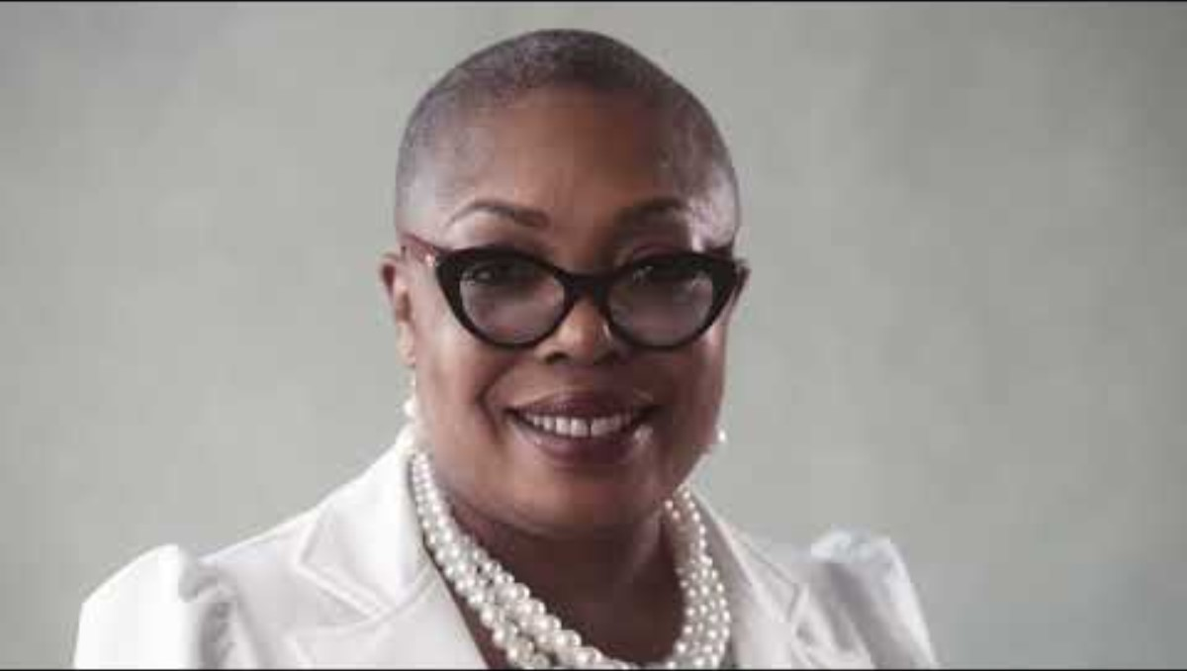
3. What is breast screening?
Breast screening is population screening designed to detect early breast cancer before any symptoms.
It is entirely free and is offered every 3 years from the age of 50-53 for first invitation, to just before a client’s 71st birthday.
A female mammographer (specialist breast screening radiographer/associate practitioner) will perform a mammogram (Breast X-ray) to screen for early breast cancer changes.
This involves a machine using a clear plastic plate to compress the breast whilst taking the X-ray. This helps to keep the breast still to achieve a good quality diagnostic image and reduce the radiation dose. Two types of images of each breast will be taken; from top to bottom and side to side, including the part of the breast that extends into the armpit.
See here a new YouTube Video made by the South East London Breast Screening Service on breast screening, featuring 12 local residents

Slide 7
Anticipation of the mammogram can be daunting but our highly trained mammographers will guide people through the examination.
It may be an 8-minute appointment, but the breast will only be compressed for a few seconds to obtain the required images. The whole experience should take no more than 30 minutes, but we advise people to please be patient with staff and the service if this does take a little longer - demand can be high.
Having a mammogram can be uncomfortable, and some people find it painful. Usually, any pain passes quickly.
IMPORTANT FACT: 80% of breast cancers occur in women and people with breasts over the age of 50 and this risk increases with age. Most people with breast cancer do not have a family history of the disease
If someone has had breast cancer, two or more close relatives have had breast/ovarian cancer, and/or this was under the age of 40, they can request a risk assessment referral from their GP or self-refer and email to attend the Cancer Risk Assessment Service (CRAS) based at Guy’s Hospital (gst-tr.cancerriskassessment@nhs.net)
Regardless of age, if anyone with breast tissue feels they have any symptoms of breast cancer they must go to their GP who can refer them to their local breast care unit
It must be noted that around 400 cases of breast cancer per year in the UK occur in people assigned male at birth

Slide 8
4. Invitations
Timed invitations, as opposed to open invites which were used in the pandemic, are sent approximately 4 weeks before their appointment. If the time/location is inconvenient clients can contact the London Breast Screening Administration Hub (020 3758 2024) to rebook or alternatively they can visit our website (Breastscreening (london-breastscreening.org.uk)). These details are on the appointment letter.
Although not automatically invited people over 71 are able to book their own appointment (self-refer) every three years. 1 in 3 breast cancers occur in the over 70’s; these people should still be encouraged to continue accessing screening
We send text reminders – usually a week before, then 48 hours before the appointment time. Ensure GPs have the correct contact information.
If someone has missed their appointment, their GP may text/call them to encourage their attendance (with up to date details!)

Slide 9
5. Reasonable adjustments
We can offer longer appointments to those with learning disabilities, physical disabilities, neurodiversity and other additional needs. GPs can share this information with us, and clients/carers can call the hub. Our contact email is Kch-tr.selbss@nhs.net
If we know of these in advance, we can flag these on the National Breast Screening System (NBSS) to make sure we can book these clients in and provide them with additional Easy Read breast screening information if required. We also have Braille breast screening leaflets at our service (please email us if you need these)

Slide 10
5. Breast Screening Flow Chart for People
Who Need Reasonable Adjustments
Clients of breast screening age (50-53, up to 71) and due screen
Breast Screening Hub Identifies people using BS Select – Draws data from NHS spine onto NBSS
People NOT identified as having LD sent invitation directly from Hub.
Invitation for timed appointment sent with local screening site
Primary Care Identified clients of breast screening age with Learning Disability, physical disability, SMI, etc.
Emails Local Breast Screening Unit via email on
kch-tr.selbss@nhs.net
Breast Screening Unit has people on NBSS data base with FLAG from previous visit and/or informed by primary care.
List of clients FLAGGED as having LD on NHS Spine/BS Select are sent to Breast Screening Unit to invite.
Hub sends out Easy Read Information Letter
Invited to appointment with increased time allocation, a double slot, known as a special appointment (at King's College Hospital or Queen Mary's Hospital Sidcup)
Possible adjustments made:
Time, Location and Date
Known wheelchair users invited to King's College Hospital or QMH Sidcup
Metal staircase becomes lift on mobile units
Can be done in wheelchair if sides come off
Can bring a companion. Can stand with radiographer behind screen if essential.
Clients should have ability to verbally consent or best decision interest is required.
DNA (did not attend)
Attends appointment but not able to have mammogram
. Attends appointment and has mammogram
DNA letter sent to GP and to Patient
Patient and GP informed.
Advised to practice breast awareness and to see GP if has symptoms.
Abnormal result further investigation.
Letter sent to patient and GP.
Normal Result
Patient and GP informed
Normal Recall

Slide 11


6. Pros and cons of attending screening
Screening may find early and small cancers that are unnoticeable but easier to treat – although every cancer treatment will look different.
Cancers found earlier can improve treatment outcomes and have better long-term survival rates
Nationally breast screening saves 1,300 lives per year. Every year in the UK 56,000 women and people with breasts are diagnosed with breast cancer
It is important for people to attend screening to take care of their health
Most people receive a result that no cancer was found
Having a mammogram every 3 years for 20 years very slightly increases the chance of developing a cancer in someone’s lifetime – this is considered low risk by the NHS
Being uncomfortable or in pain during or just after the mammogram
Some cancers may not be detected by mammography
Potential anxiety and worry if you are called back for further assessment
Each year approximately 4000 people in the UK will be treated for breasts cancers that would not have affected them in their lifetime. This is called over diagnosis.

Slide 12
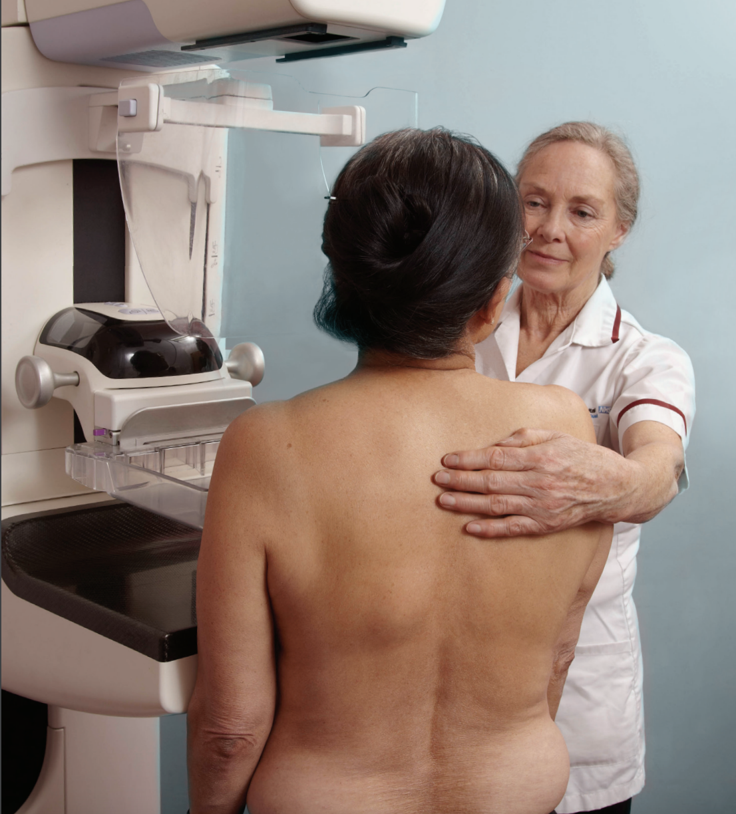
7. Tips for screening attendance
Clients will need to undress to the waist in the privacy of the X-ray room so it’s a good idea to wear clothing they can easily take off (ideally a top and skirt/trousers rather than a dress/jumpsuit)
Clients should not wear talcum powder and spray on deodorant as this can show up on a mammogram – roll-on deodorant is fine
Questions that will be asked during the appointment: if someone has breast implants, or if they have any current breast symptoms.
Generally, it is advisable someone attends alone, unless they have someone they need, for example, for translation support. It may be that a support person can wait in the waiting room at our static sites. On our mobile units space is limited so we may not be able to accommodate your support person on the van.
We can’t look after children or dependents during screening in the waiting room. They cannot come into the X-Ray room.
Source: NHS breast screening: helping you decide leaflet

Slide 13

8. Results
Results will be sent to the client usually within two weeks of a screening appointment
If we need to invite someone back for further investigations, they will be sent an appointment letter within three weeks; they may also receive a phone call to confirm attendance the day before the scheduled appointment. Within the letter there is a number to call the breast care nurses at King’s if they have any questions.
If someone does get called back for further assessment, they will have a clinical examination, may have further mammograms, an ultrasound and possibly a biopsy. The majority of those who get called back for further assessment will not have cancer.
Some people will be recalled because the initial mammogram that was taken was not adequate. In this instance they will usually be invited back to the original screening location to have these images repeated; known as a technical recall.
REMEMBER: If someone feel any changes in their breasts, even if they’ve been recently screened, ALWAYS see a GP
They can call Breast Cancer Now nurses helpline if you have any anxieties or worries in the meantime: 0808 800 6000

Slide 14
9. Breast Aware Health Promotion
Whether people choose to attend breast screening or not it is still important to be breast aware and regularly check the breasts (ideally monthly!) – this is also something that those under screening ages should do.
Key symptoms of breast cancer are: new lumps in the breasts and/or armpits, discharge from the nipples, change in size or shape of the breasts, puckering, dimpling or rash on the skin, inversion of the nipple: see the NHS website for the comprehensive list
We like to use the acronym T, L, C: touch your breasts/chest, look for changes, check with a GP
20% of cancers occur in under 50s, with mounting evidence that black women may experience higher rates of more advanced cancers (stage 3 and 4) cancers. Charities such as Black Women Rising have conducted important research on these inequalities
Share appropriate information, such as this guide for those with learning disabilities on how to check your breasts
Reduce primary risk factors for breast cancer by limiting alcohol consumption under 14 units, aiming for a healthy weight, quitting smoking, eating a balanced diet, and staying active. See here the NHS Better Health app for tips and resources
Breastfeeding can also reduce someone’s risk of getting breast cancer
Hormonal medication carries some risk: see information on HRT or any earlier use of contraception
However, there are some factors that influence someone developing cancer that can’t be changed. These include increasing age, genetics, breast density, having started their period at an early age, later menopause, etc.

Slide 15
10. Promoting screening
Display our breast screening posters
Encourage the local community to attend their breast screening appointment, rebook if the appointment is inconvenient or it’s been missed
We want to highlight key messaging on what to expect and around making an informed choice to attend breast screening
Attend a formal breast screening training for your organisation
Share messaging about being Breast Aware
Promote healthy lifestyles that can potentially prevent illness developing
Sharing approved messaging from the NHS comms toolkit on breast screening, making use of awareness dates/months on social media, such as on Facebook
Sharing the glossary with your community and see here the languages the NHS has translated as a breast screening leaflet
Ordering free Breast Cancer Now information in relevant local languages
Sharing Breast Cancer screening videos in the resources section
Getting in contact with us with any feedback or suggestions on our outreach: Kch-tr.selbss@nhs.net
Notes:
Reference GP guide

Slide 16
11. Resources
  Breast screening "It's in Your Hands" video (the subsequent four videos were designed by students at UAL and Southwark Council)
  Speak Up video discussing religious taboos
  Say no to Cancer Video discussing cancer is not necessarily a death sentence
  Talking about cancer as a community video
  Check your breasts video by Black Women Rising x Coppa Feel
  The Beauty of Support video and website by Macmillan in Black Hairdressers in SEL
  Breast screening patient video, with subtitles, specifically targeted for ethnic minorities etc.
  Shorter video on breast screening with service-users with learning disabilities
  Go for it breast screening video for service-users with learning disabilities
  BSL Breast Awareness Video
  The Bread Exam Video (how to check your breasts as seen via demonstrating on bread dough with no mention on the word breast)
  Ethnic communities hub by Breast Cancer Now
  Storyline leaflet on breast screening by Beyond Words (for those with LD and/or autism etc.)
  MMC campaign across SEL
  October 2024 new SELBSP breast screening campaign
Notes:
Gendered resources
Best for my chest campaign

Slide 17
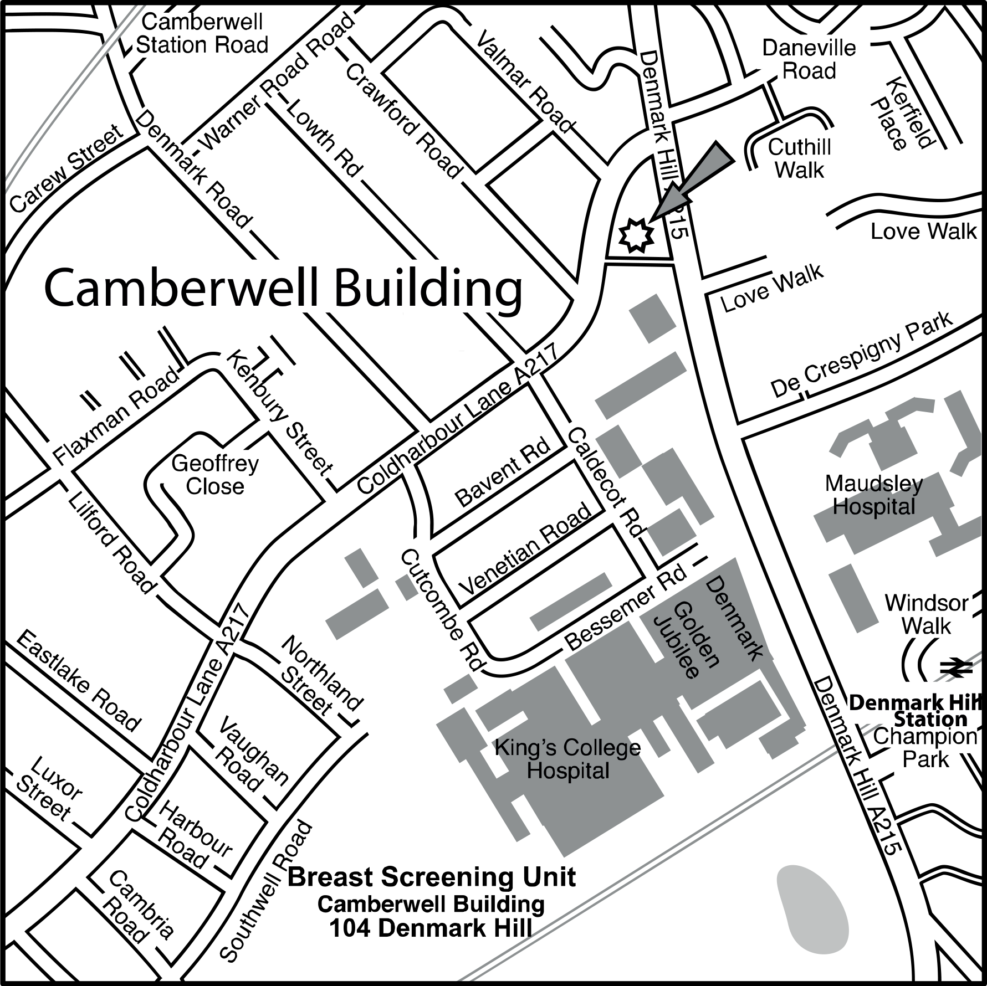
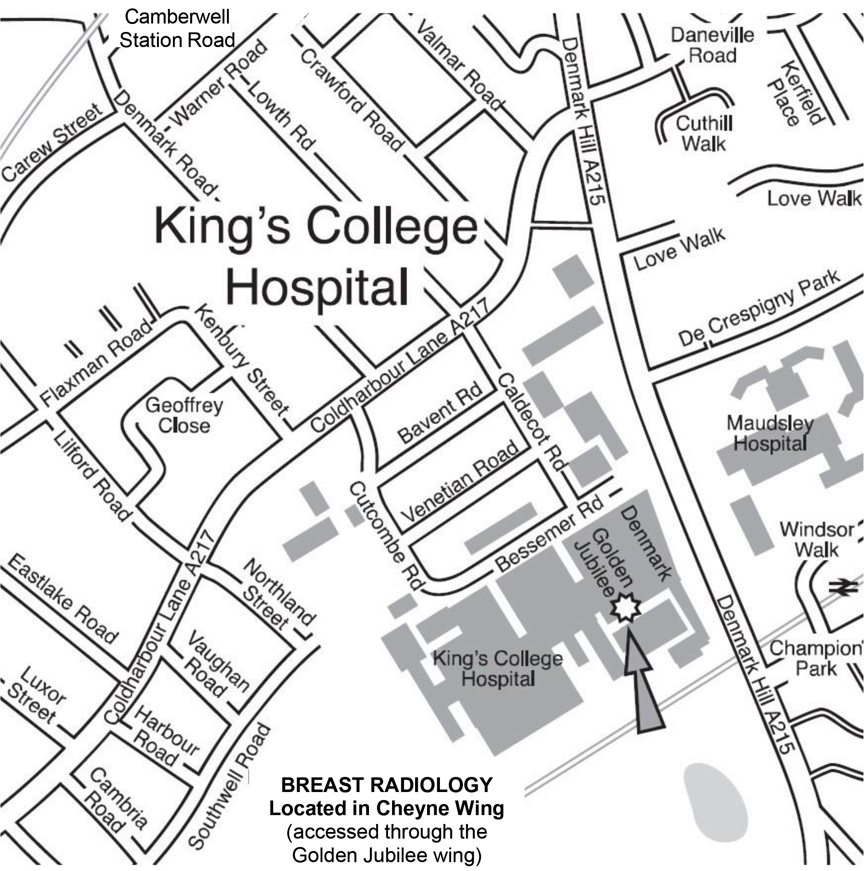
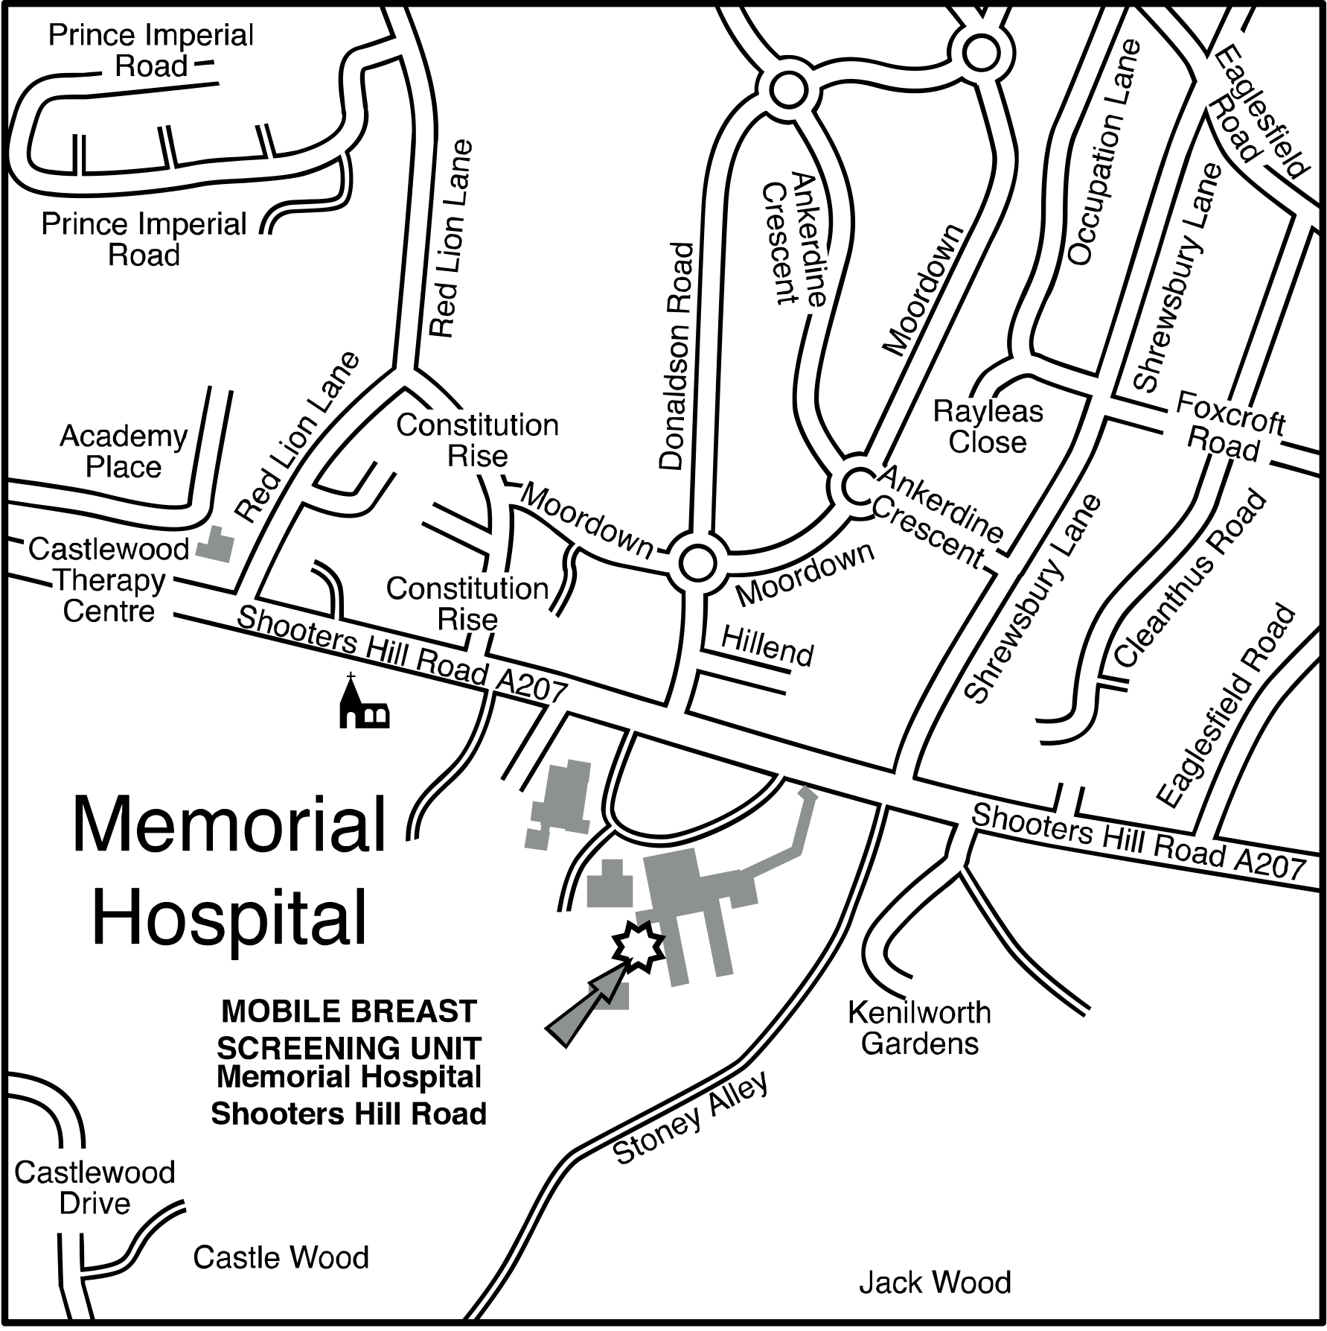
12. Screening locations
Further information about the locations can be found by clicking on the links.
Lambeth and Southwark, also SELBSP office site at 104 Denmark Hill
Site at King’s College Hospital for longer appointments, symptomatic pathway screening and further assessment
Greenwich mobile unit, Memorial Hospital

Slide 18
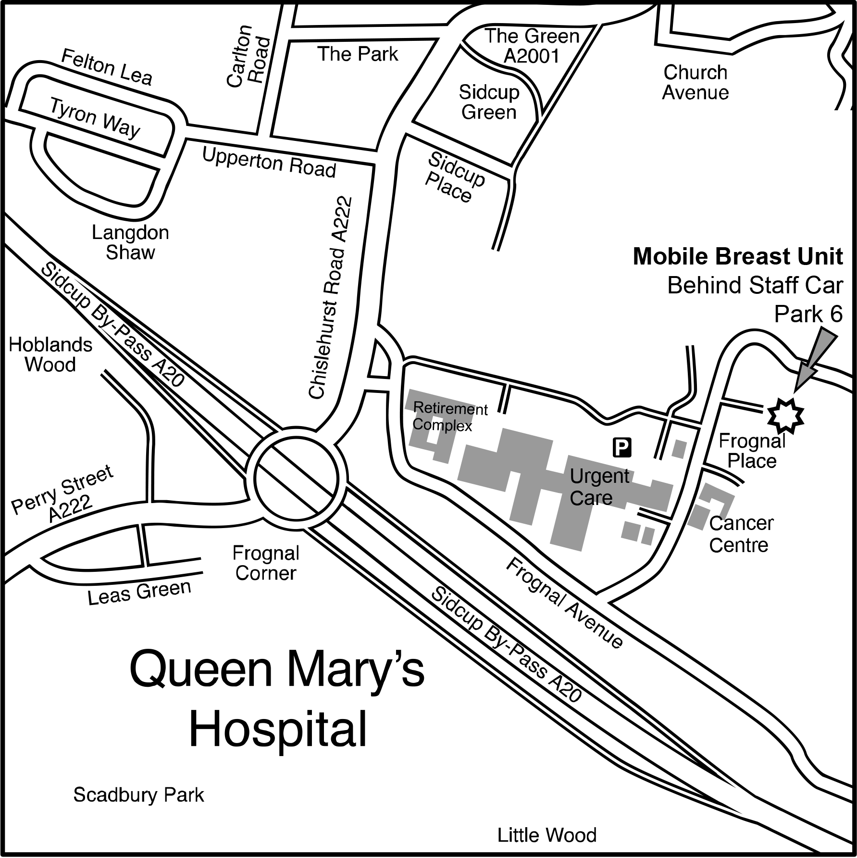
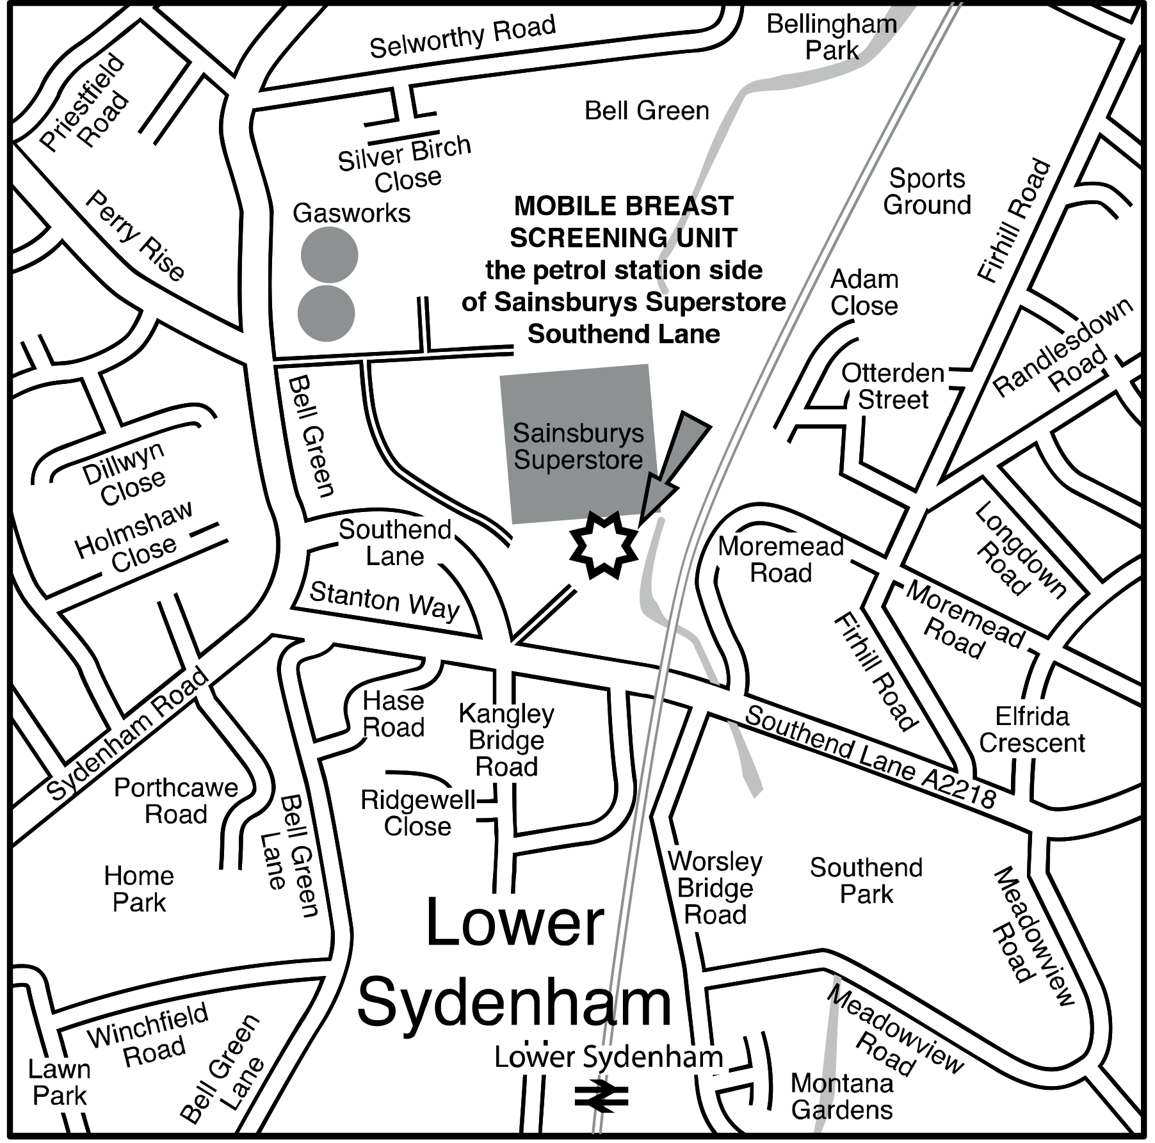
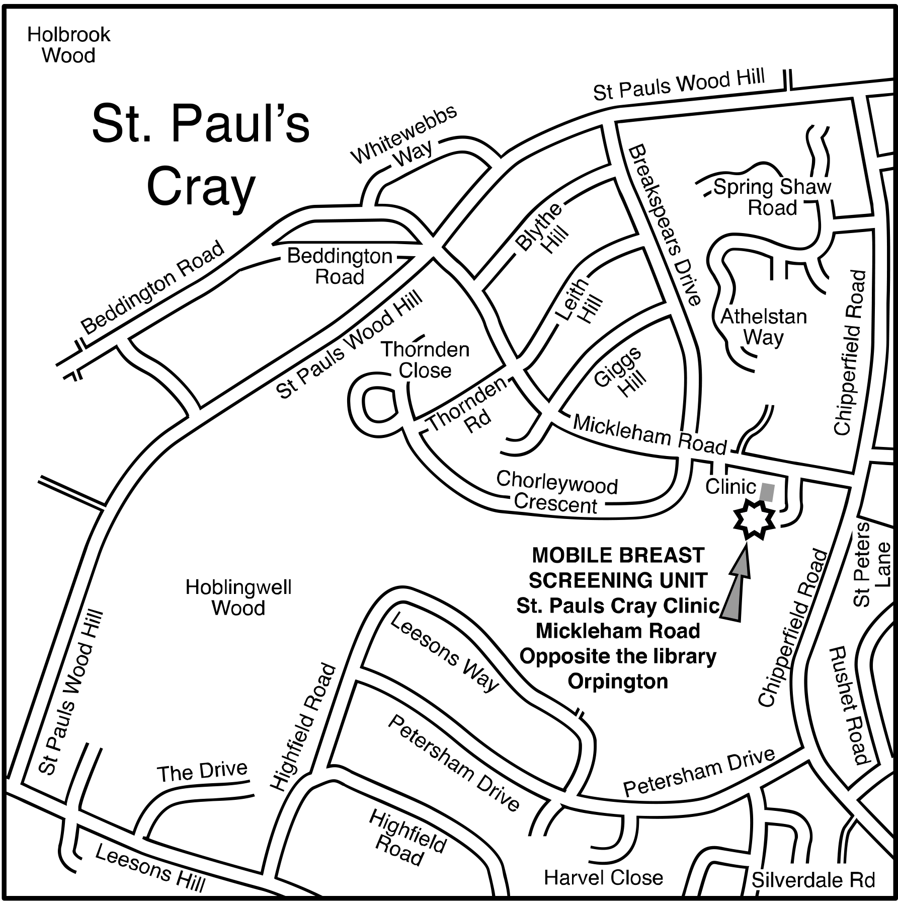
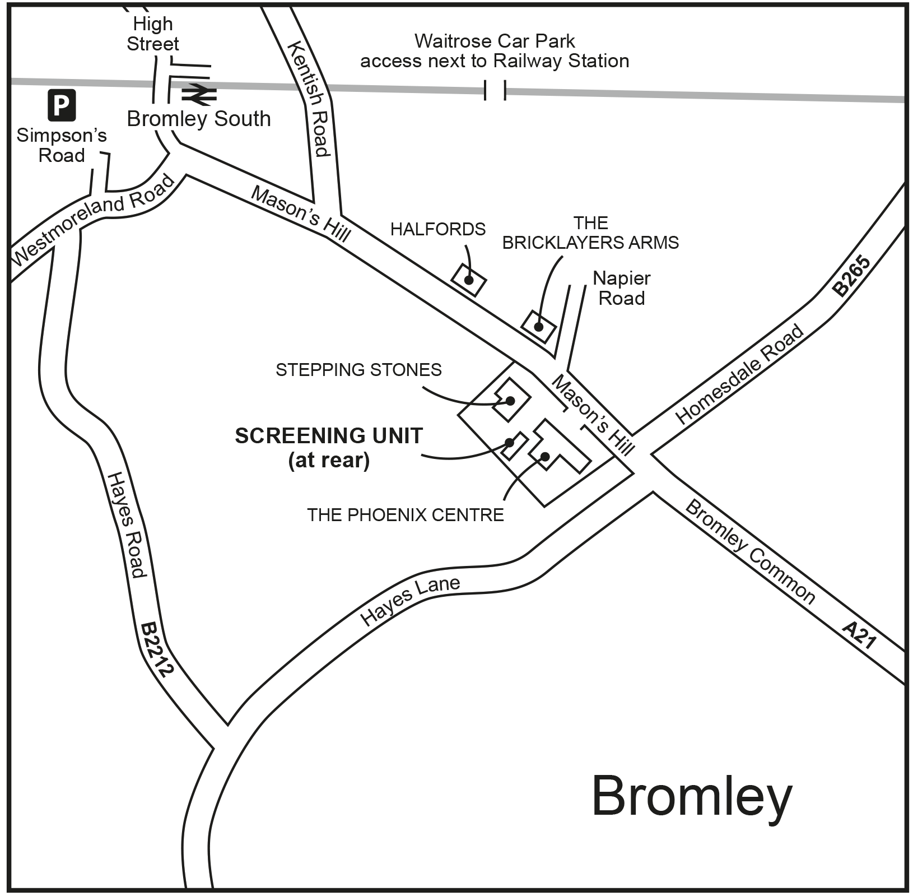
Bexley mobile units, Queen Mary's Hospital
Lewisham mobile unit, Sydenham Sainsbury’s
Bromley mobile unit,
St Paul’s Cray
Bromley mobile unit, The Phoenix Centre

Slide 19
Contributors
Xianne Aguiar - Cancer Improvement Manager - Breast and Gynae
Tracey Blancke - SELBSP Programme Manager
Francesca Fiennes – Health Promotion Specialist, SELBSP
Zara Gross - Early Diagnosis Lead, SELCA
Jessica Hannah - SELBSP Service Manager
Juliet Morel - Consultant Radiologist, King’s College Hospital
Kirsty Nash - Cancer Facilitator (Bexley, Greenwich Lewisham), SEL ICB
Eileen Pearson - Cancer Facilitator (Bromley, Lambeth and Southwark), SEL ICB
Patricia Rodrigues - Deputy Superintendent, King’s College Hospital
Janet Sedgwick - Lead Clinical Nurse Specialist, King’s College Hospital
Chris Wanstall - Cancer Improvement Manager – Inequalities and Early Diagnosis, SELCA
Alice-Amanda Hinton – Co-Chair of Kings & Queers Network, King's College Hospital

